Slide 1
Barrow Blueway
Project Update April 2026

Slide 2
Updates since March 2024
Completion of the towpath works from Lowtown to Athy (46km) in partnership with Waterways Ireland, Laois County Council.
Completion of all connectivity links, road crossings (controlled and un-Controlled) as well as associated road safety improvements at these junctions were delivered by John Craddock Ltd and are now completed with the recent commissioning of the controlled crossing at Rathangan Spencer Bridge completed early this year.
The structures element of the Blueway is currently ongoing and nearing completion of the new pedestrian bridge west of Spencer Bridge Rathangan.
Completion of the upgrades to jetties along the Barrow line by Waterways Ireland.
Signage is currently being procured by Waterways Ireland and intended for installation by mid year 2026.

Slide 3
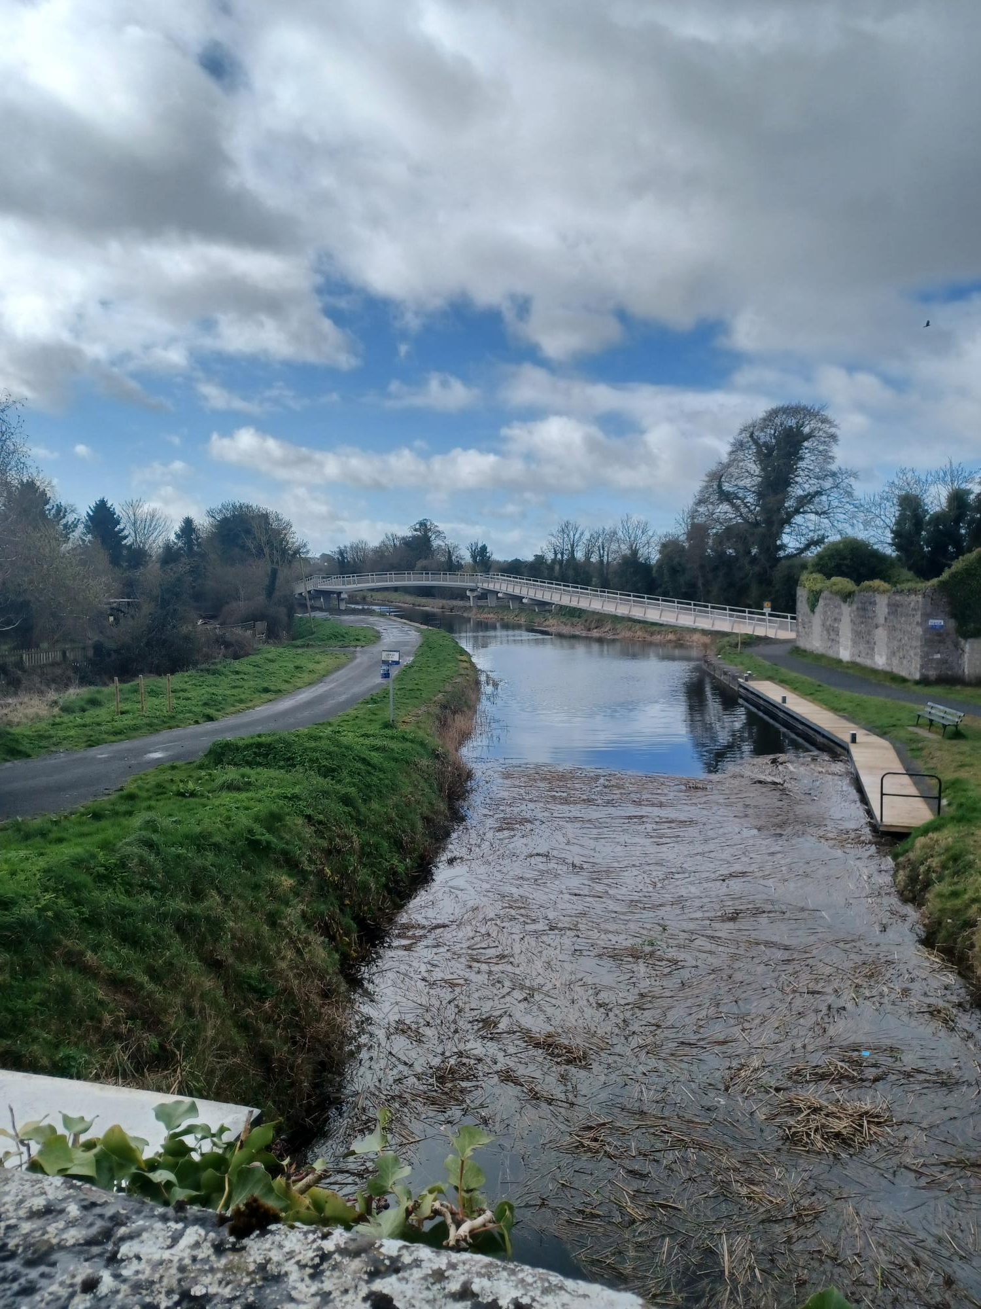
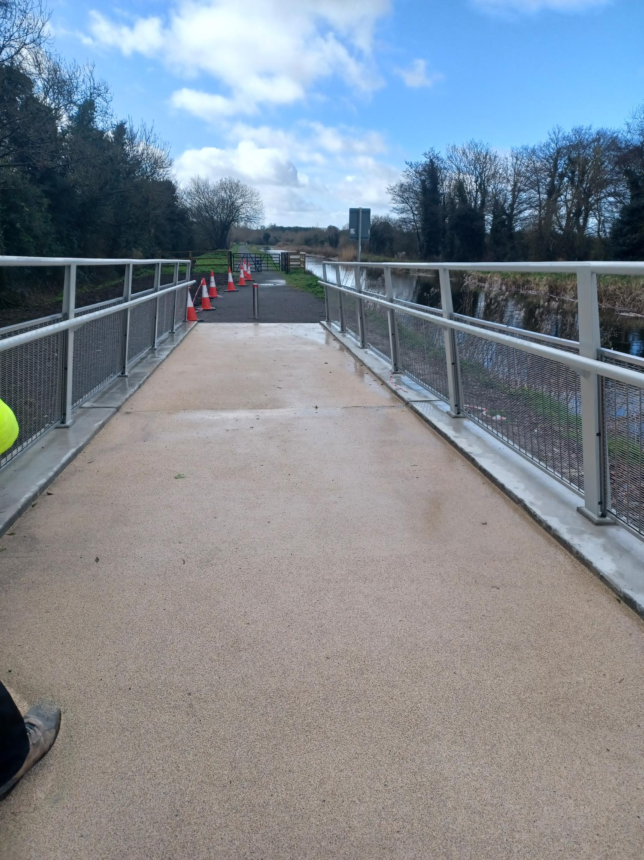
Rathangan
Pedestrian Bridge installed November 2025

Slide 4
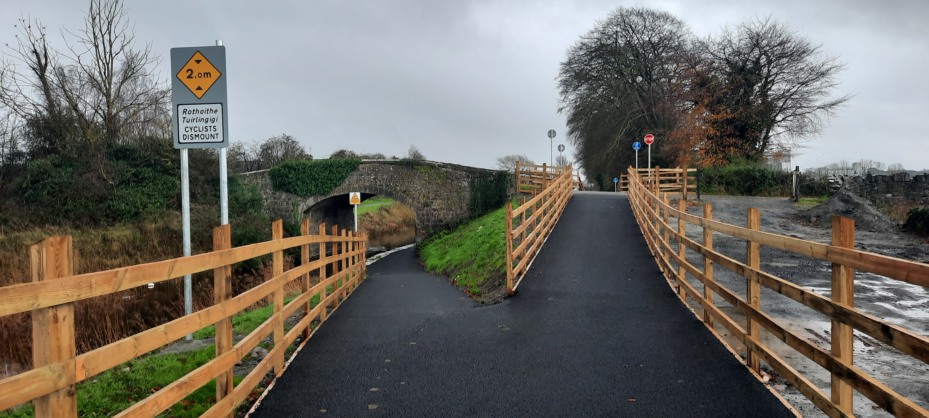
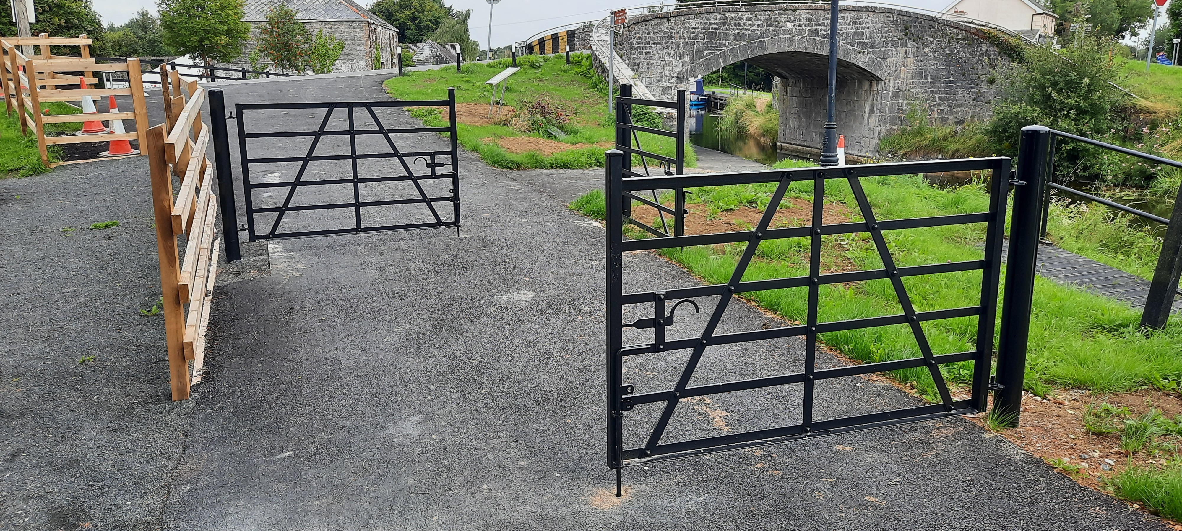
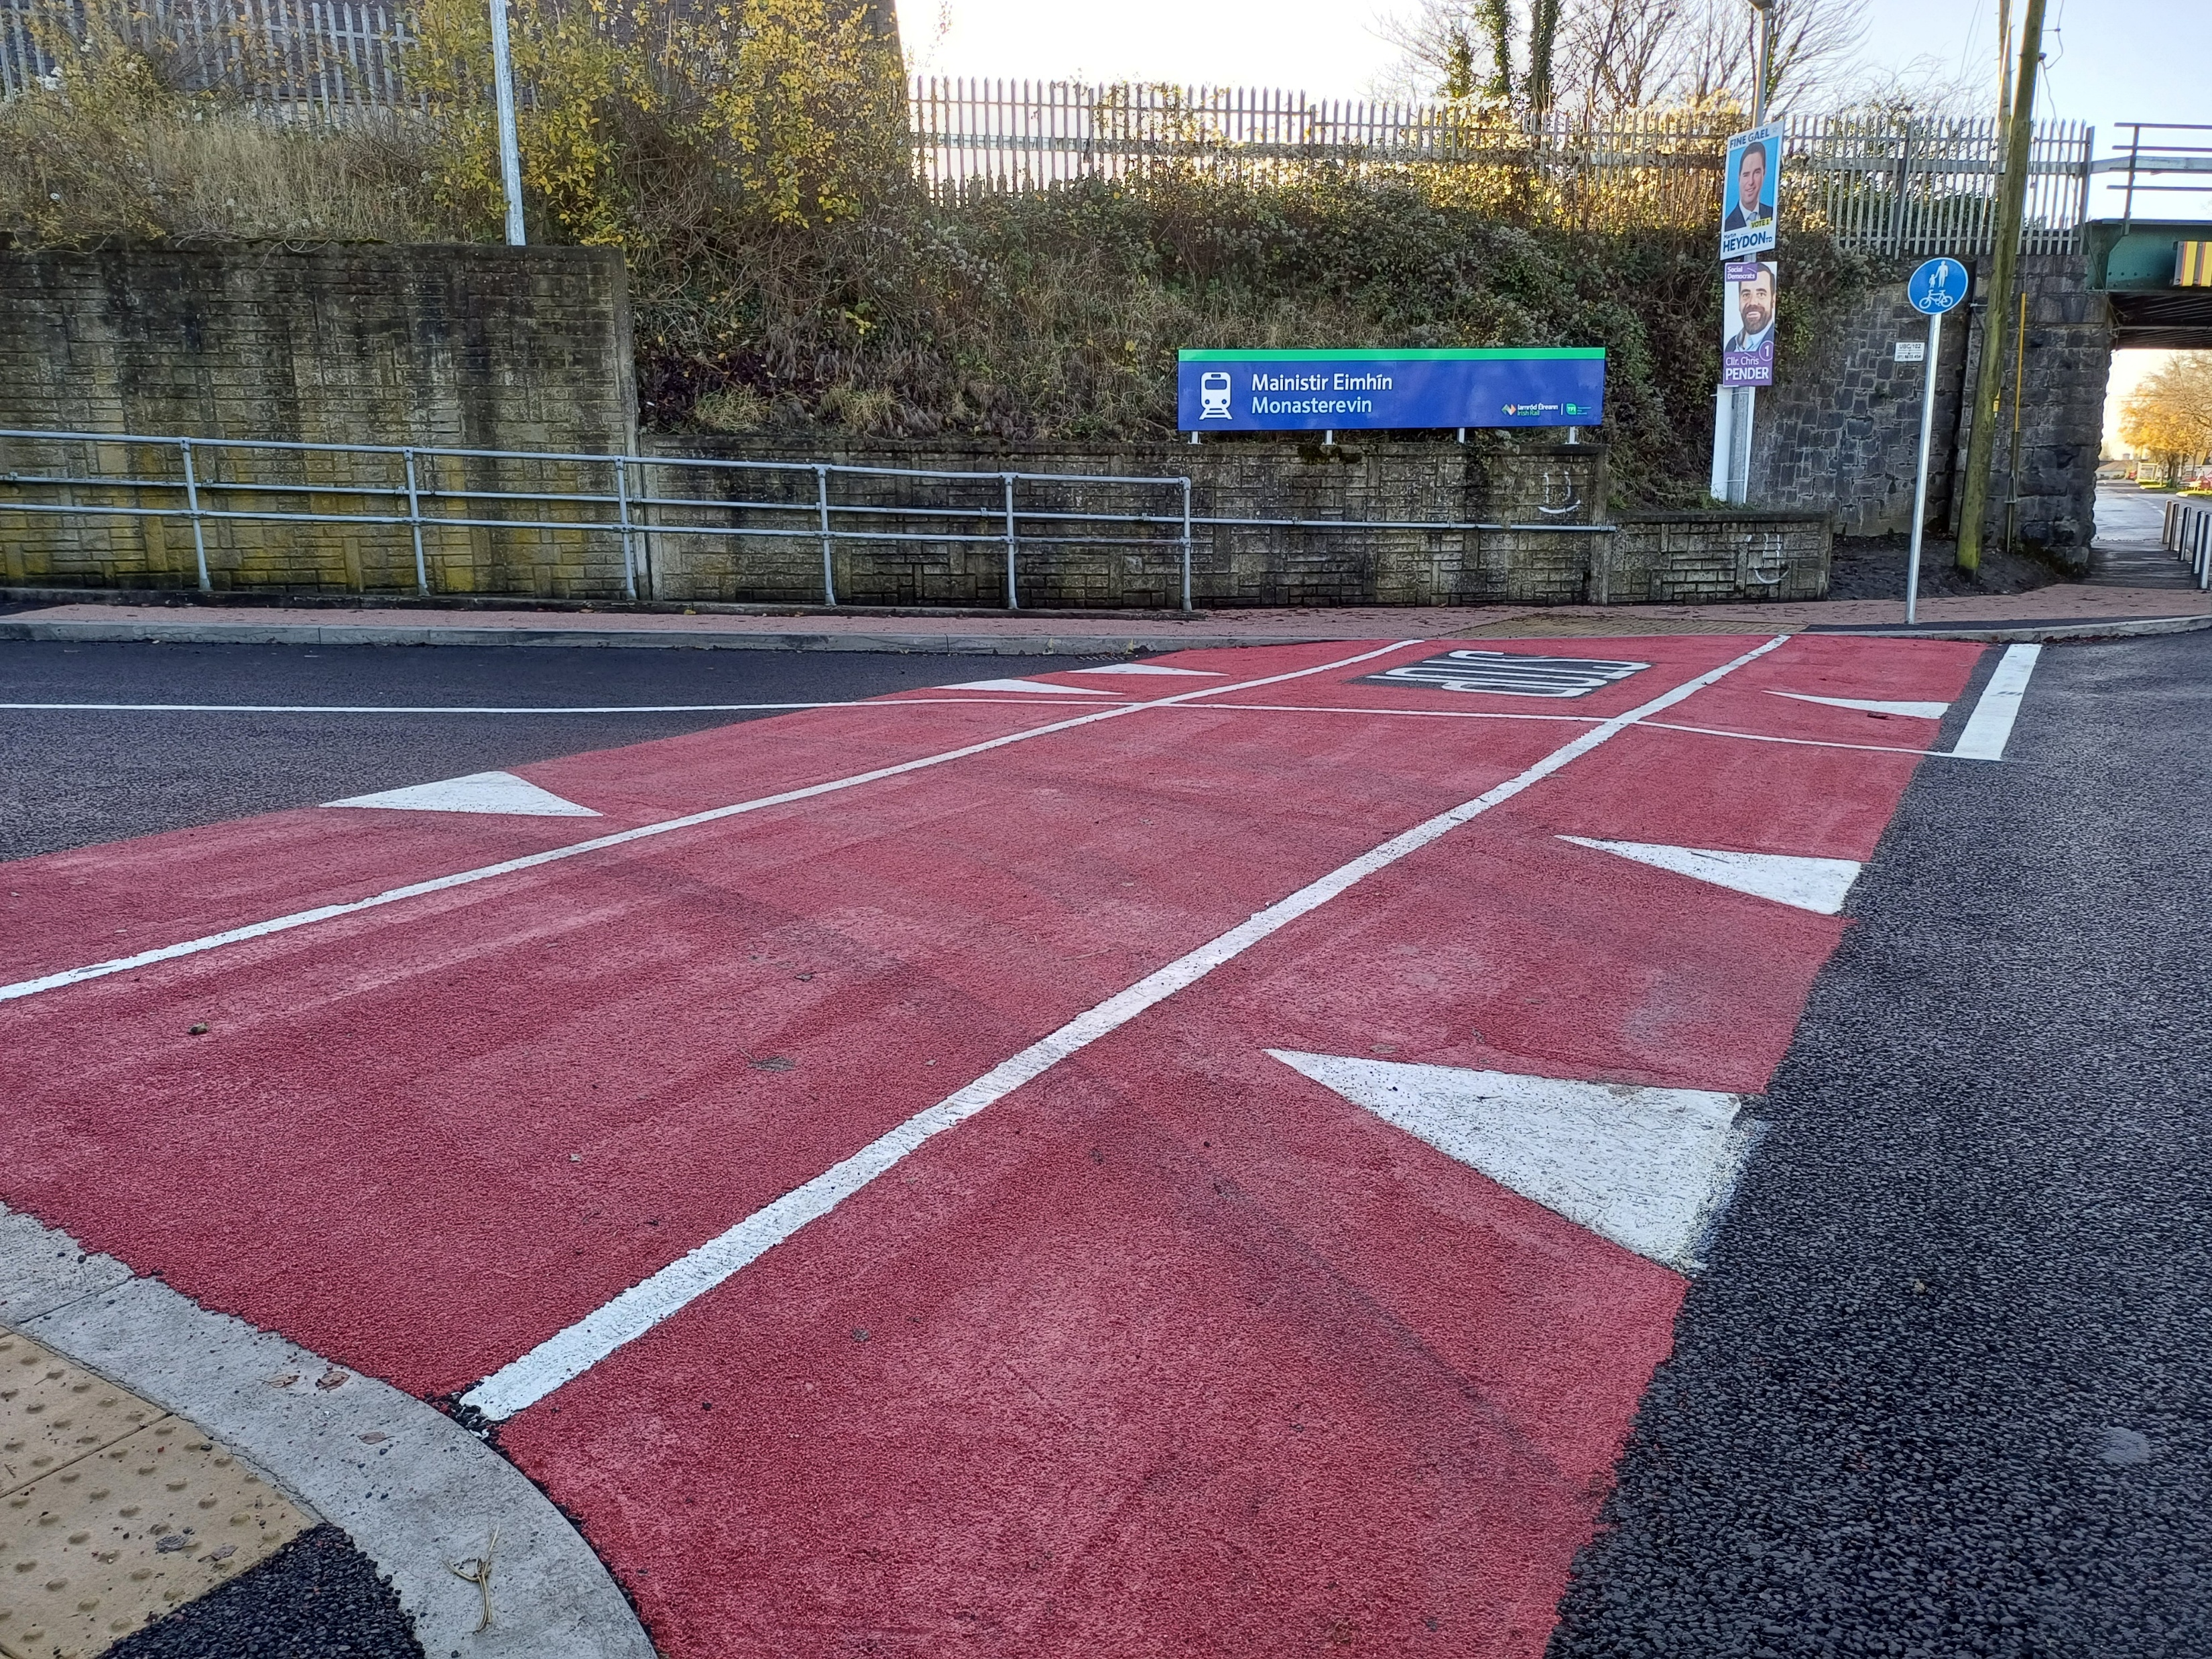
Intersections between Towpaths and Roadways

